Slide 1
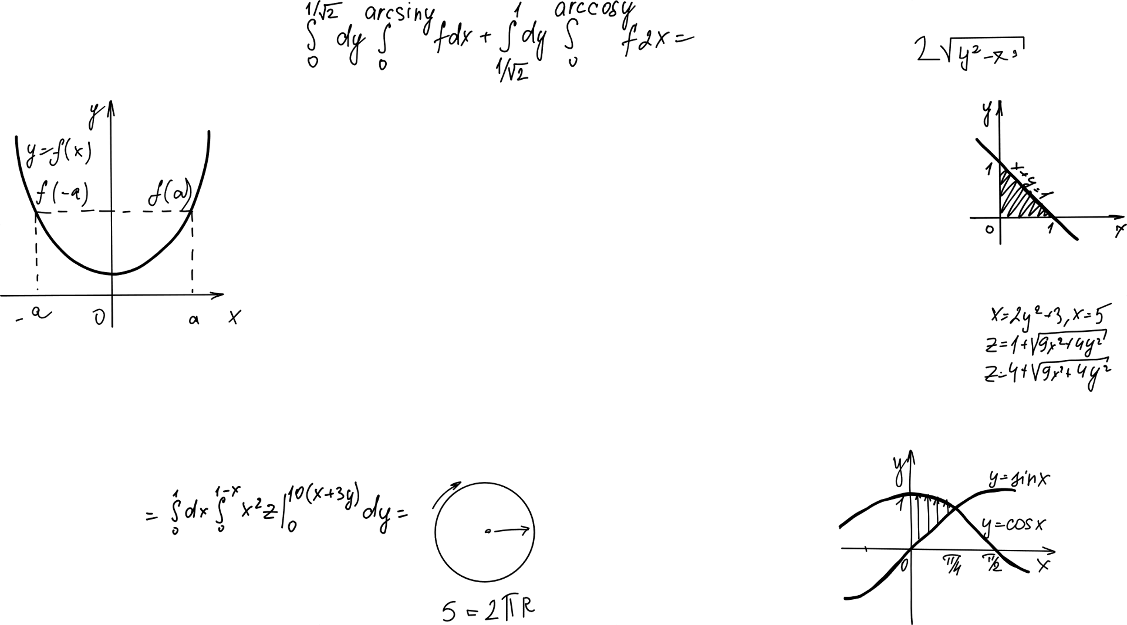

Variation of Parameters
Differential Equations

Slide 2
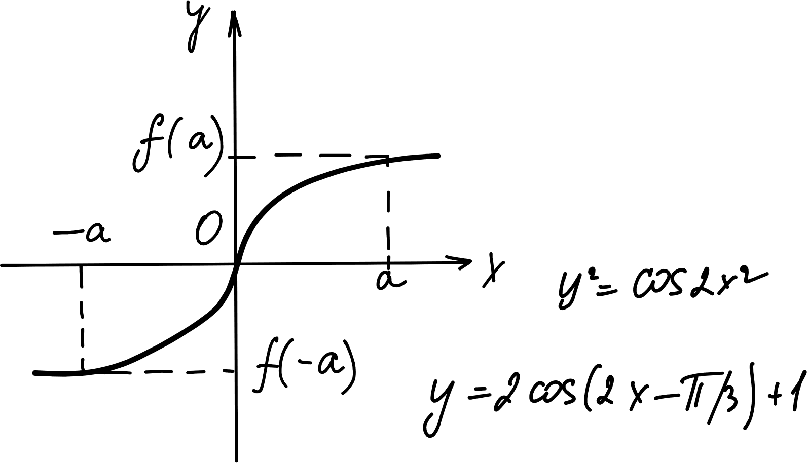
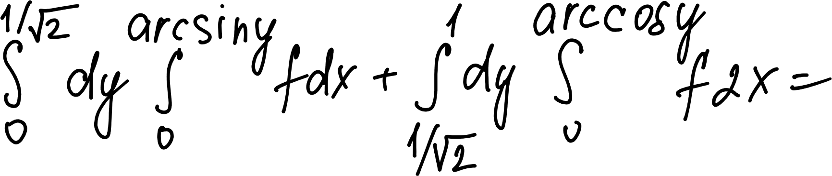
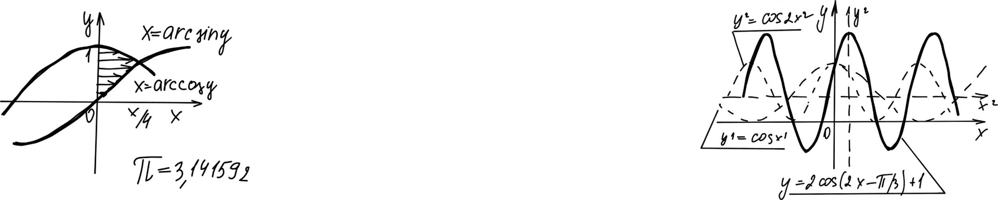
Rana Muhammad Daniyal 051
Abdullah Mazhar 066
Ahmad Nafees 086
Ali Akbar Gondal 061
Abu Umair 306

Slide 3
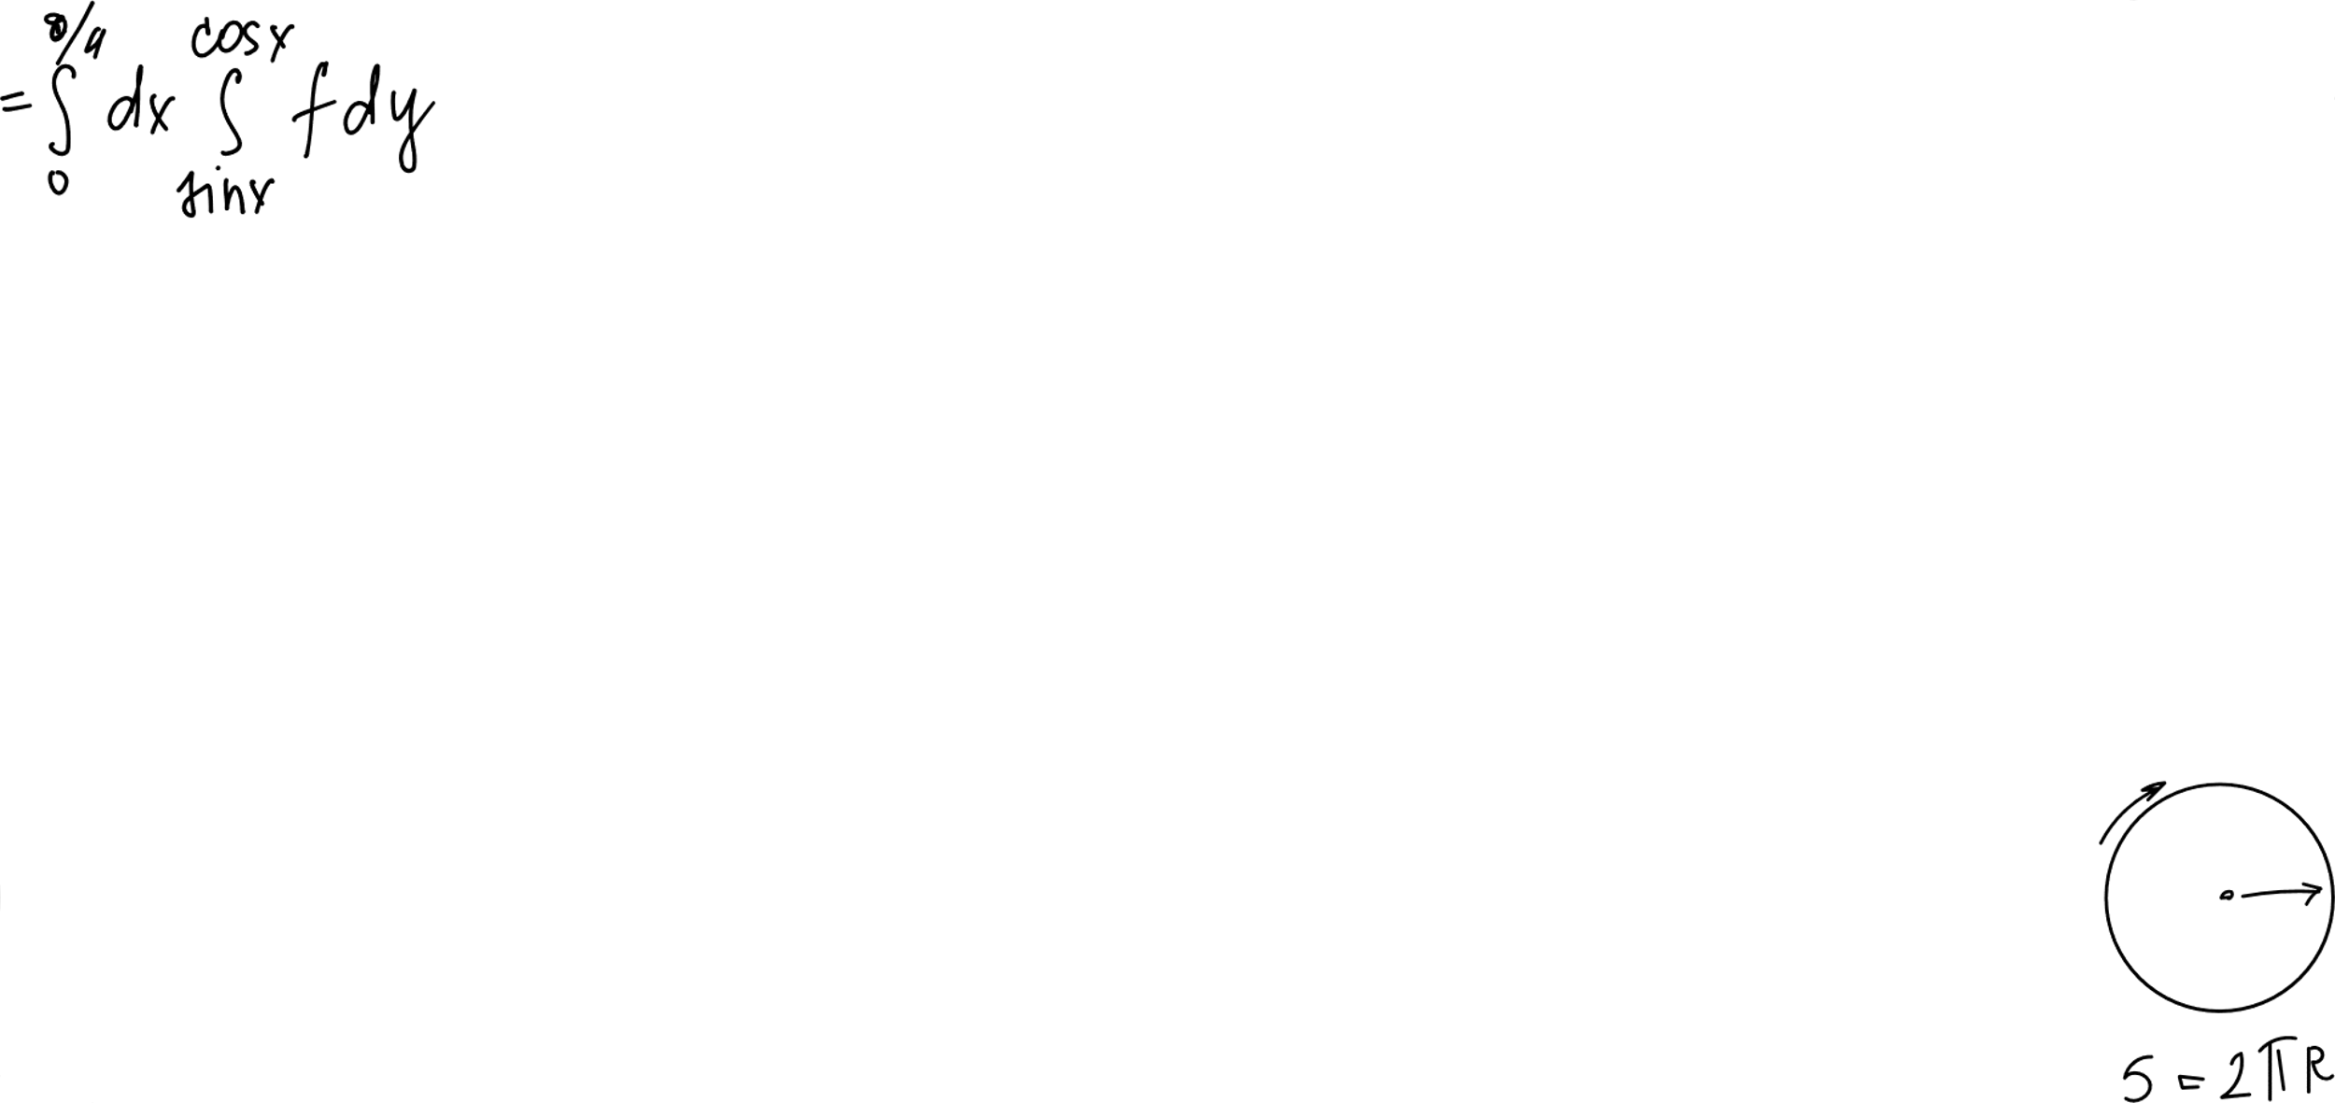
What is Variation of Parameters?
Solving Non‑Homogeneous Differential Equations
"Undetermined Coefficients is a specific key. Variation of Parameters is the Master Key."
The Problem:
Standard methods (like Undetermined Coefficients) are limited.
They fail when the function is complex, like tan(x), sec(x), or ln(x).
The Solution:
"Variation of Parameters" is a universal method.
It works for ANY linear non-homogeneous equation.
Today's Goal:
We will solve the equation: y'' + y = sec(x)

Slide 4
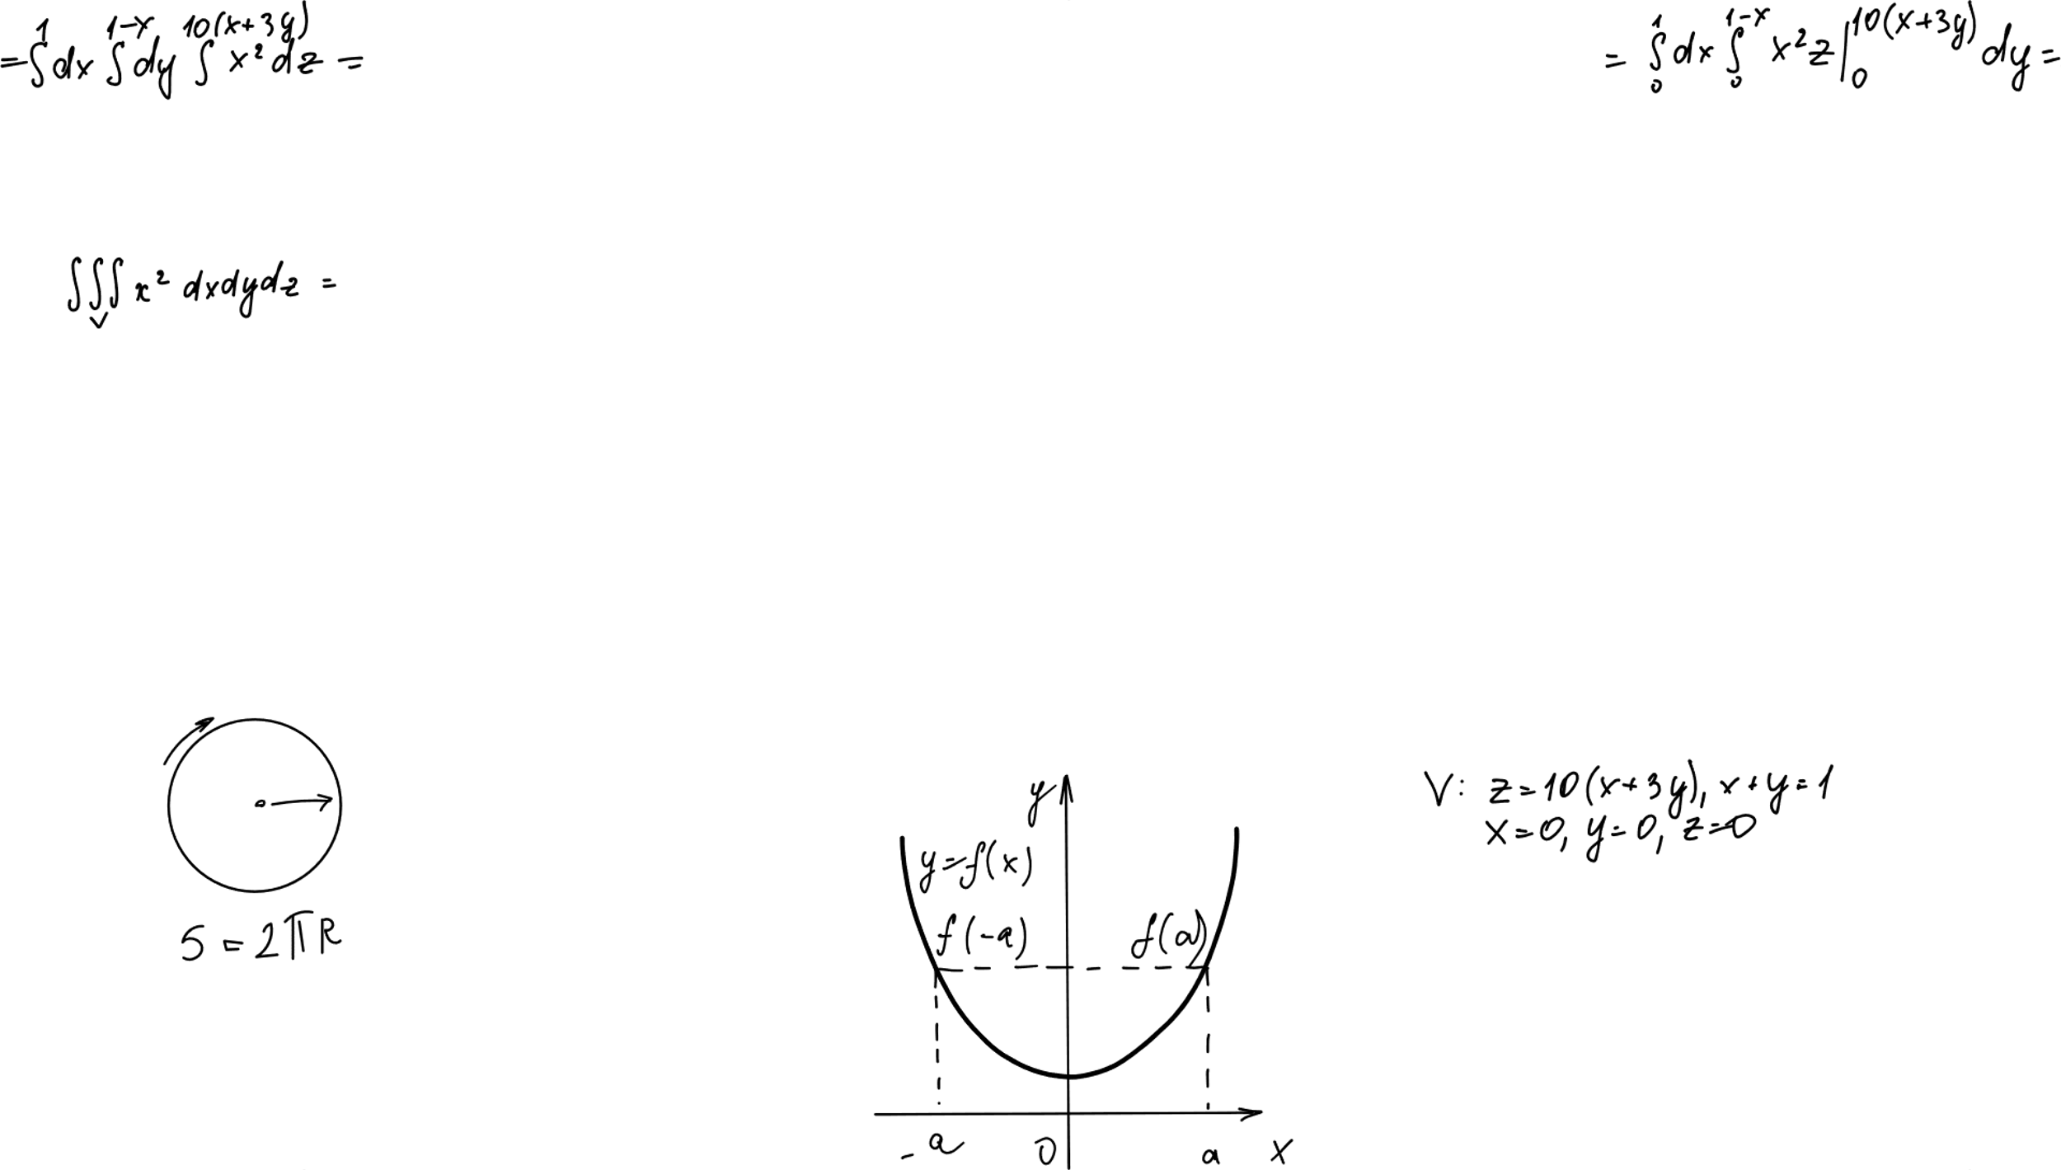
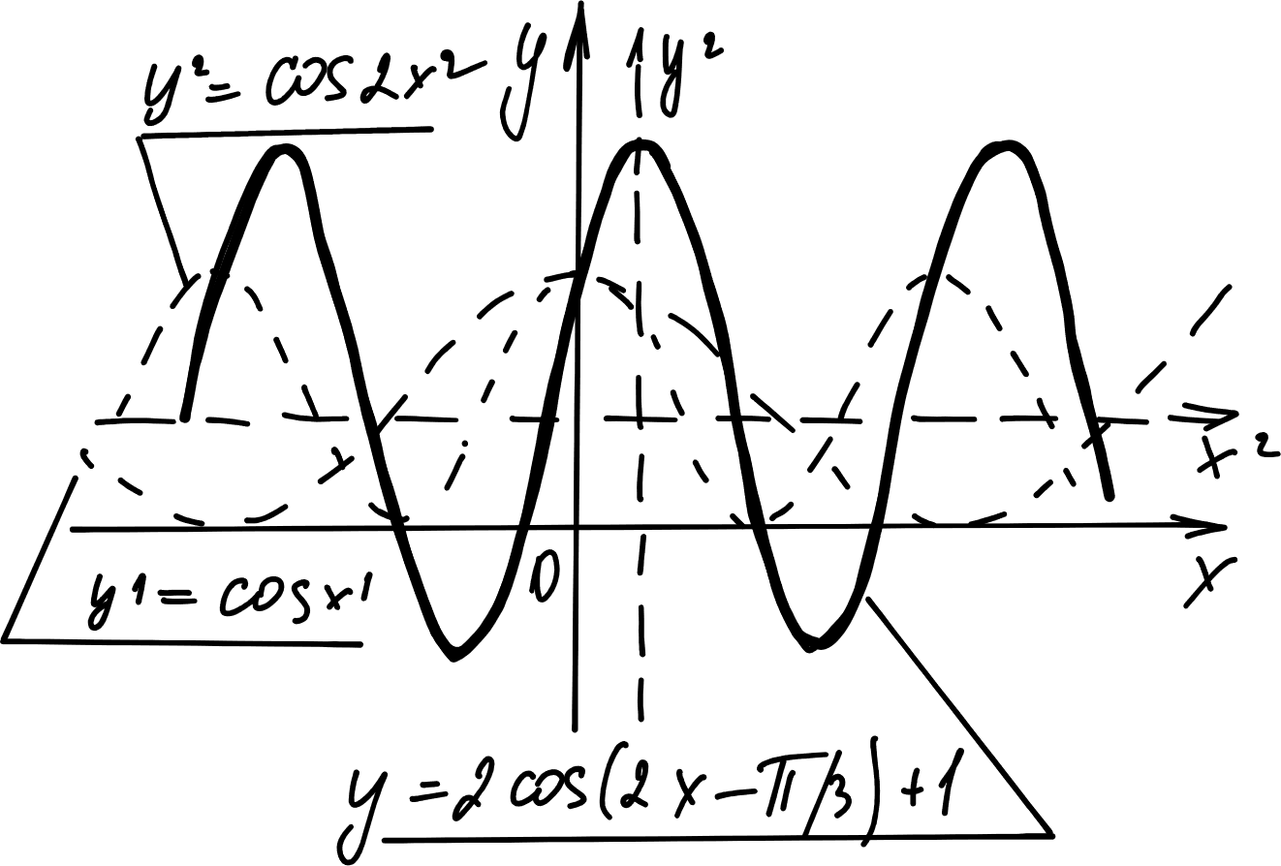
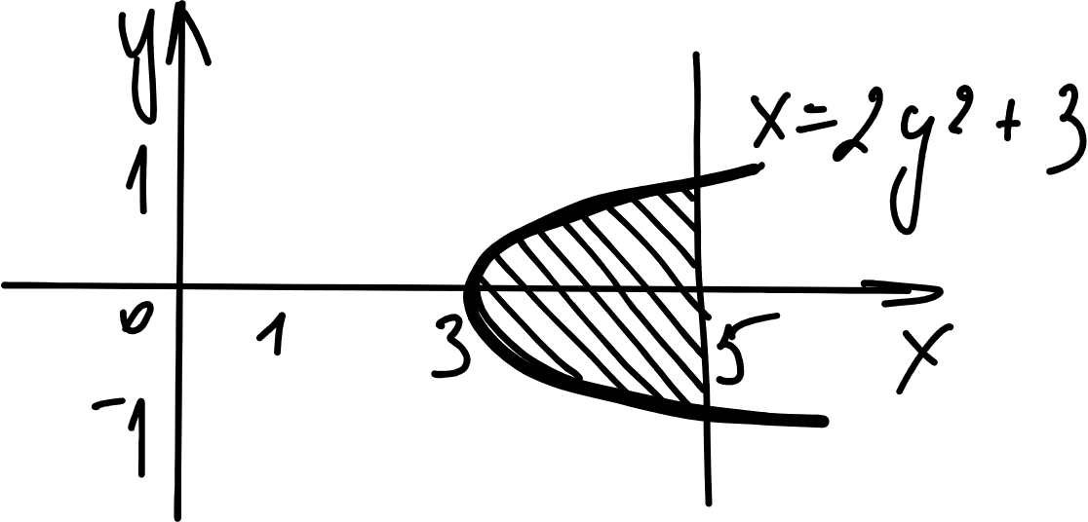
From Constants to Variables
The Old Way (Homogeneous):
The solution usually looks like this:
y_c = C1y1 + C2y2
(Here, C1 and C2 are just constant numbers).
The New Strategy:
We "Vary the Parameters" by changing those constants into Variable Functions.
Replace C1 with u1(x)
Replace C2 with u2(x)
The Target Equation:
y_p = u1y1 + u2y2

Slide 5
Our 4-Step Algorithm(RoadMap)
Step 1: Homogeneous Solution (y_c)
Solve the easy version (equals 0). Find y1 and y2.
Step 2: The Wronskian (W)
Calculate the determinant to check for independence.
Step 3: Integration (u1 & u2)
Use the "Golden Formulas" to find the missing variables.
Step 4: The General Solution
Combine everything for the final answer.

Slide 6
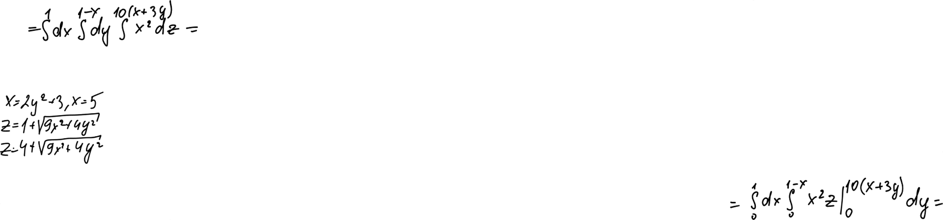
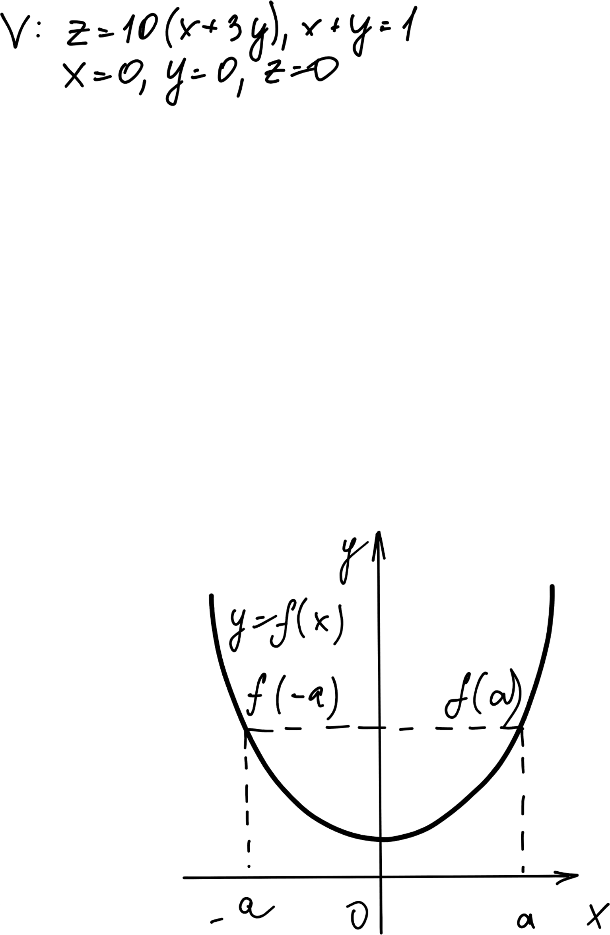
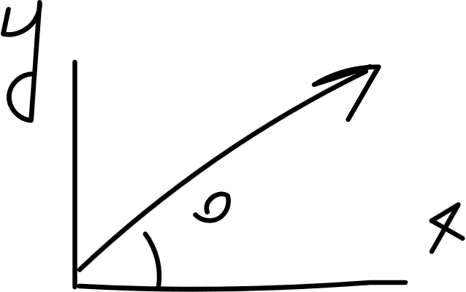
Setting Up the Problem

Slide 7
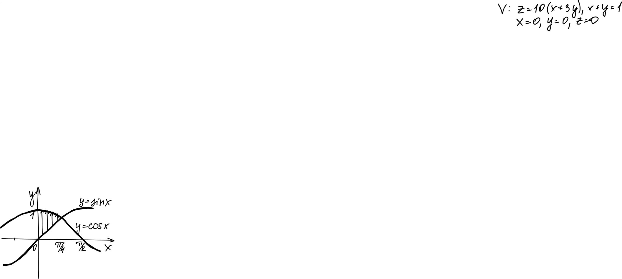
Analyze the Equation
The Equation:
y'' + y = sec(x)
Check Standard Form:
Rule: The y'' term must have a coefficient of 1.
Check: We have 1y''. (This is correct).
Note: If we had 2y'', we would have to divide the whole equation by 2.
Identify f(x):
Our function f(x) is sec(x).

Slide 8
The Auxiliary Equation
Solving the Homogeneous Part
Set to Zero:
y'' + y = 0
Auxiliary Equation:
m^2 + 1 = 0
Solve for m:
m^2 = -1
m = +/- square root of (-1)
m = +/- i (Imaginary Roots)

Slide 9
Finding y1 and y2
The Solution Form:
For imaginary roots, we use Cosine and Sine.
y_c = C1cos(x) + C2sin(x)
CRITICAL STEP:
We must separate our two main functions to use later.
y1 = cos(x)
y2 = sin(x)
(Remember these! We need them for the next step).

Slide 10
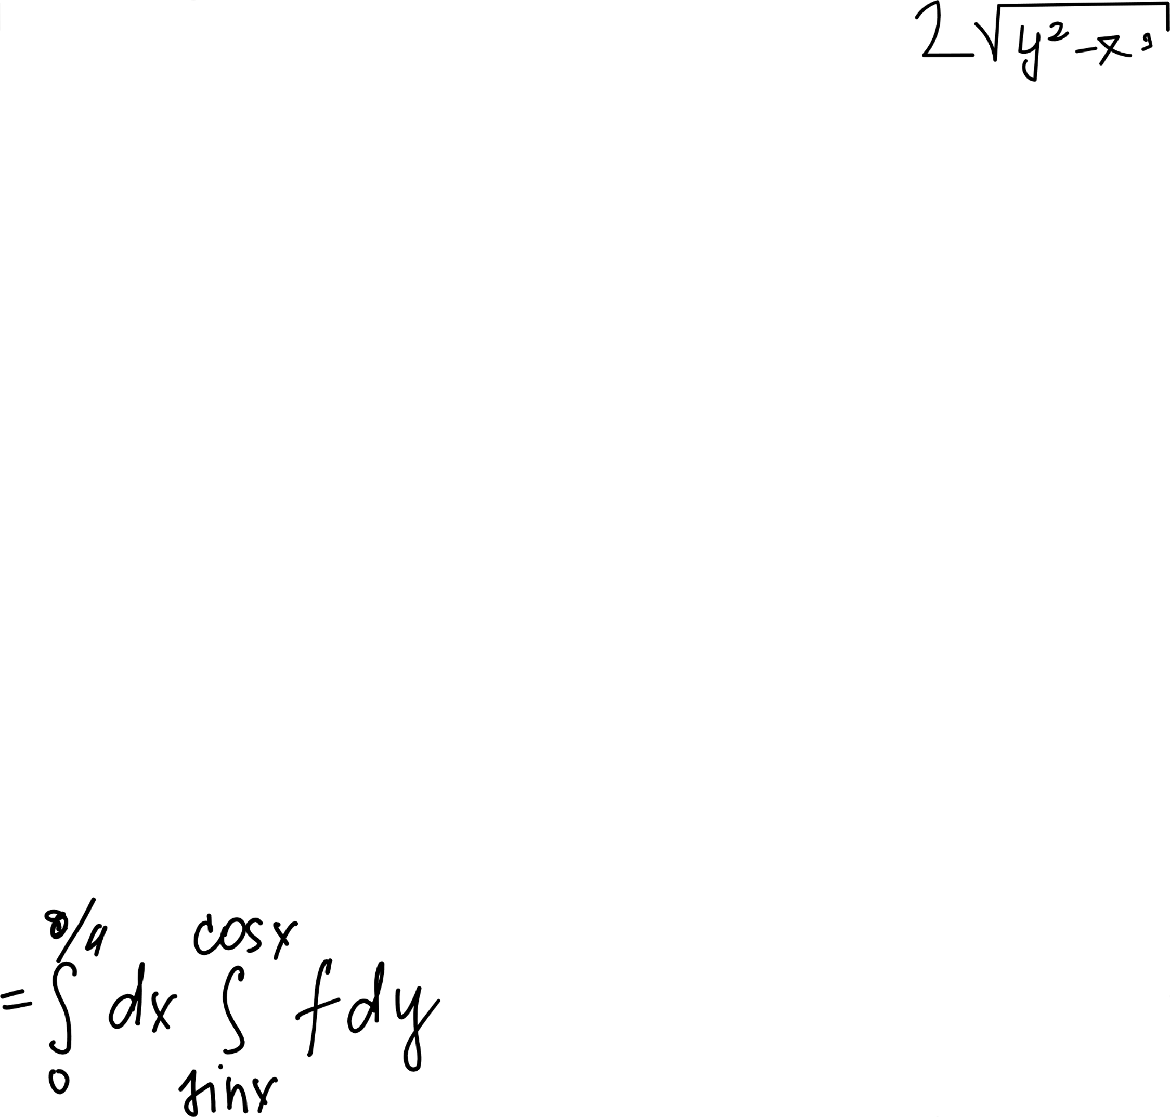
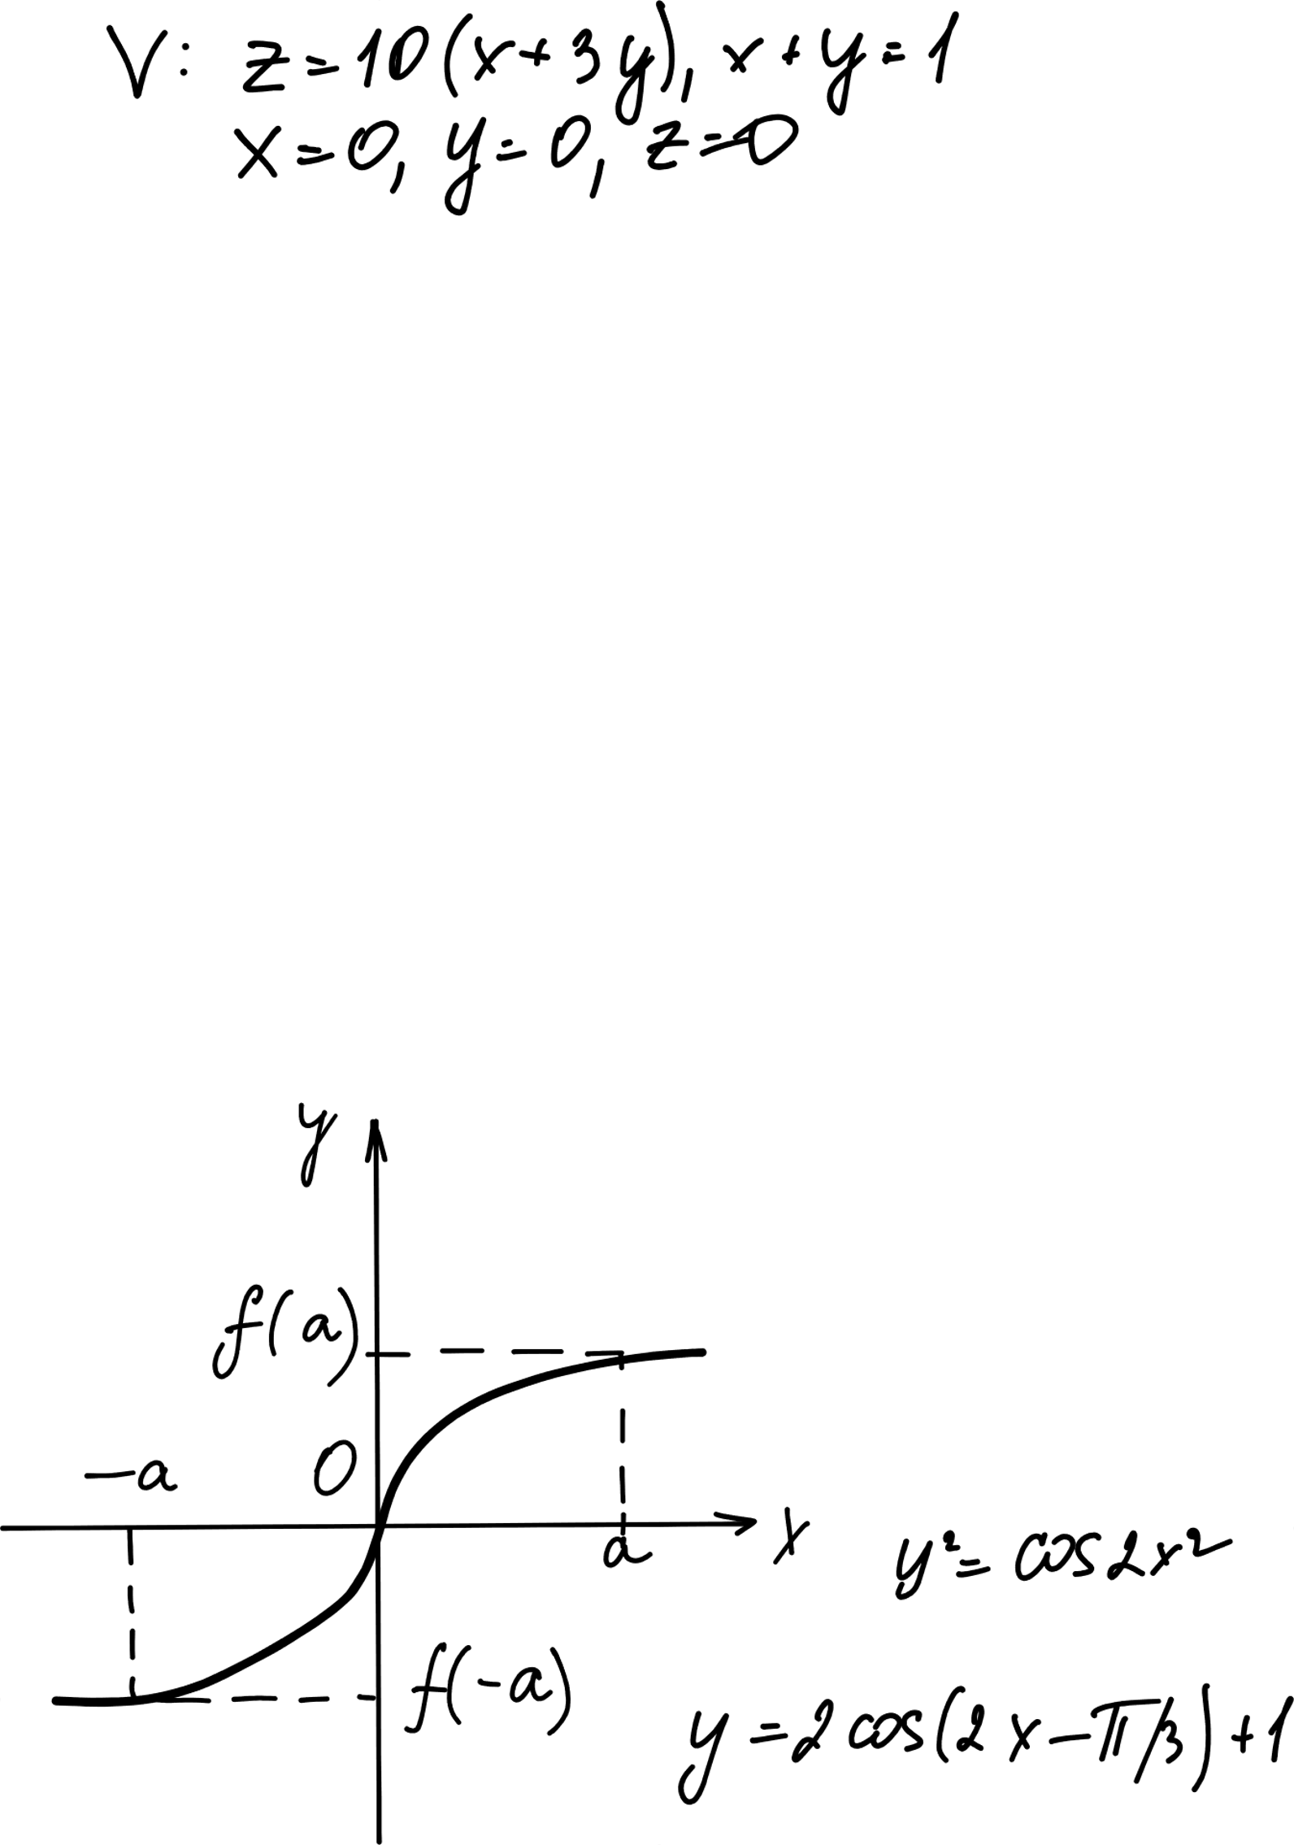
The Wronskian

Slide 11
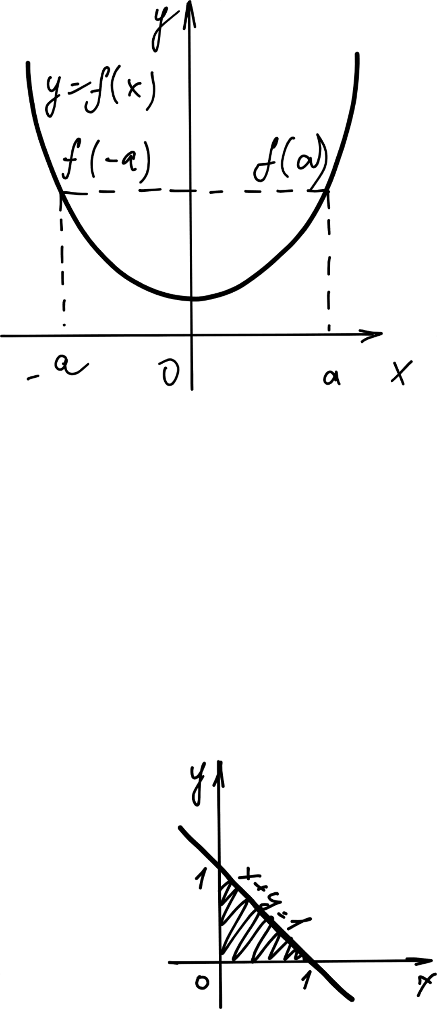
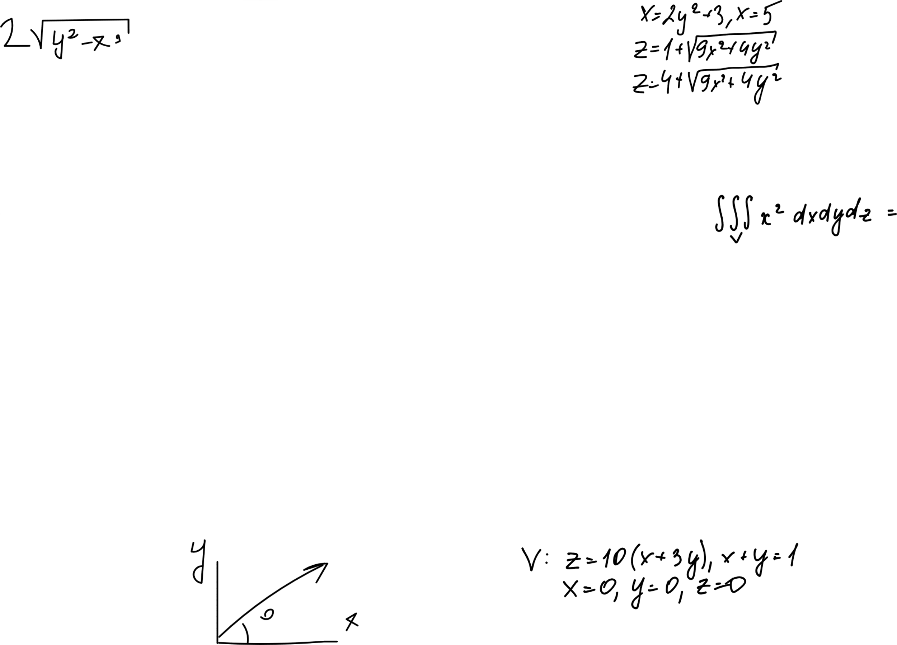
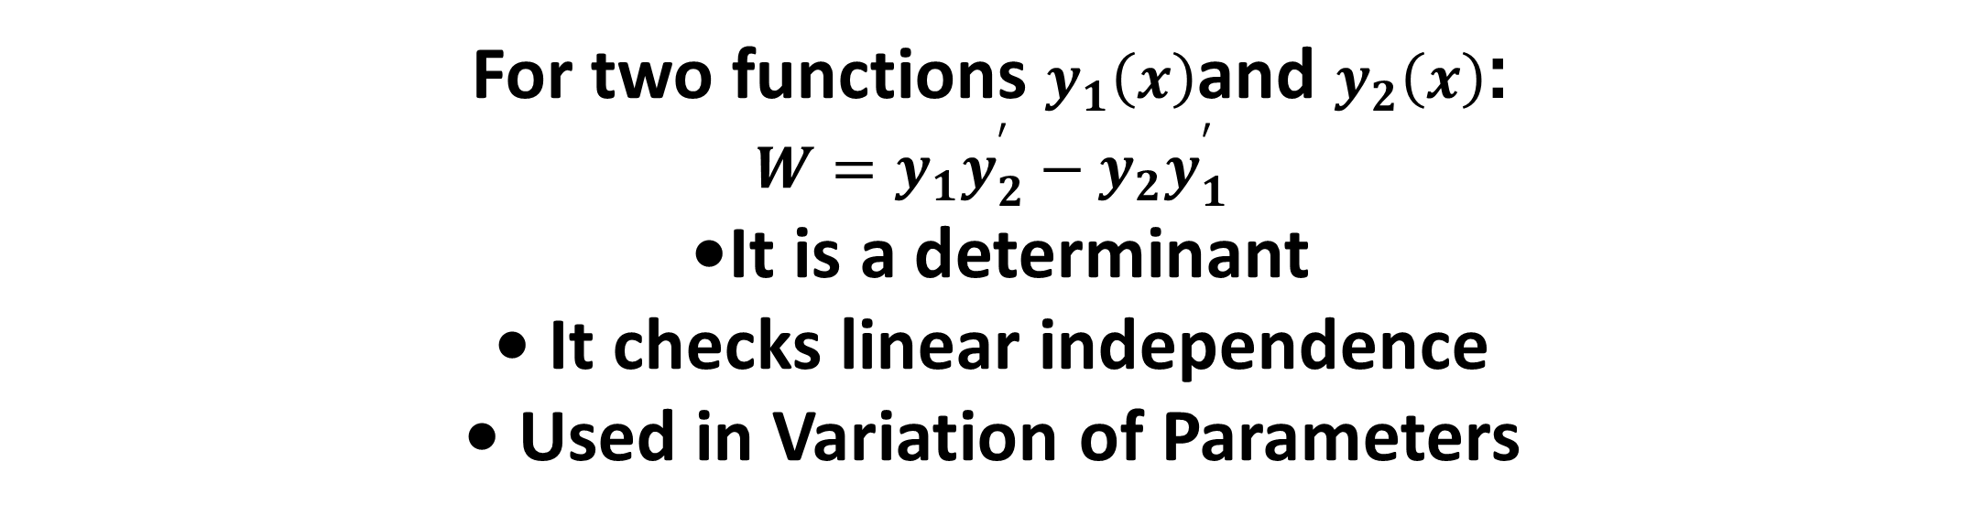
Defining the Wronskian
For two functions $y_{1}\left(x\right)$and $y_{2}\left(x\right)$:
$$W=y_{1}y_{2}^{′}−y_{2}y_{1}^{′}$$
• It is a determinant • It checks linear independence • Used in Variation of Parameters

Slide 12
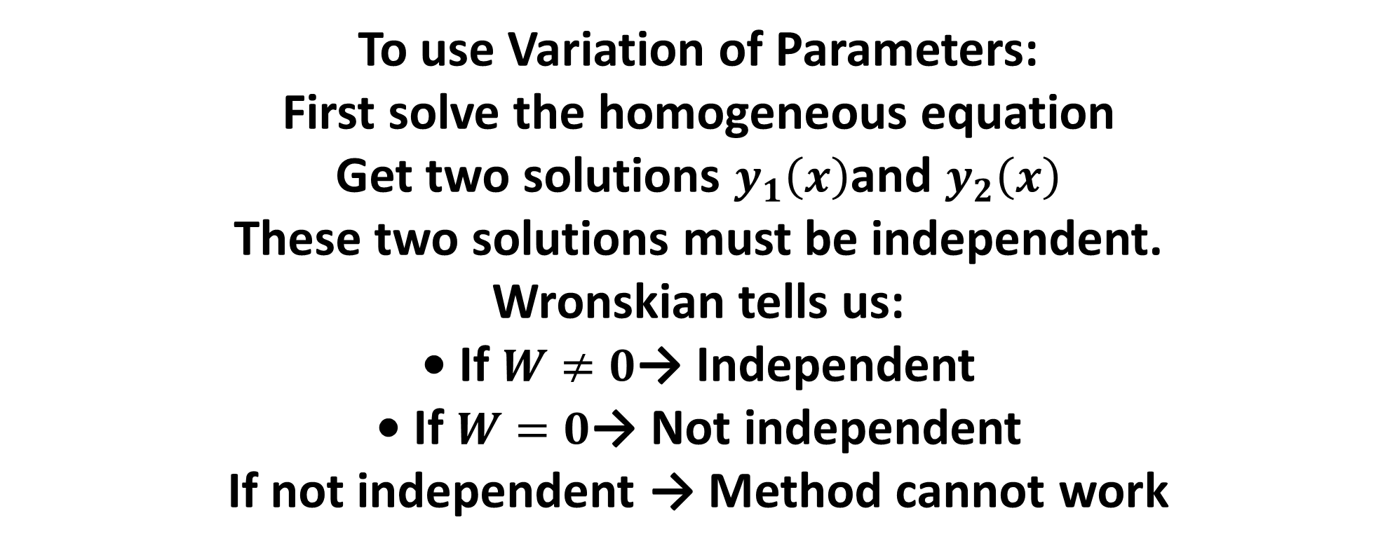
Why Is Wronskian Needed?
To use Variation of Parameters:
First solve the homogeneous equation
Get two solutions $y_{1}\left(x\right)$and $y_{2}\left(x\right)$
These two solutions must be independent.
Wronskian tells us:
• If $W≠0$→ Independent • If $W=0$→ Not independent
If not independent → Method cannot work

Slide 13
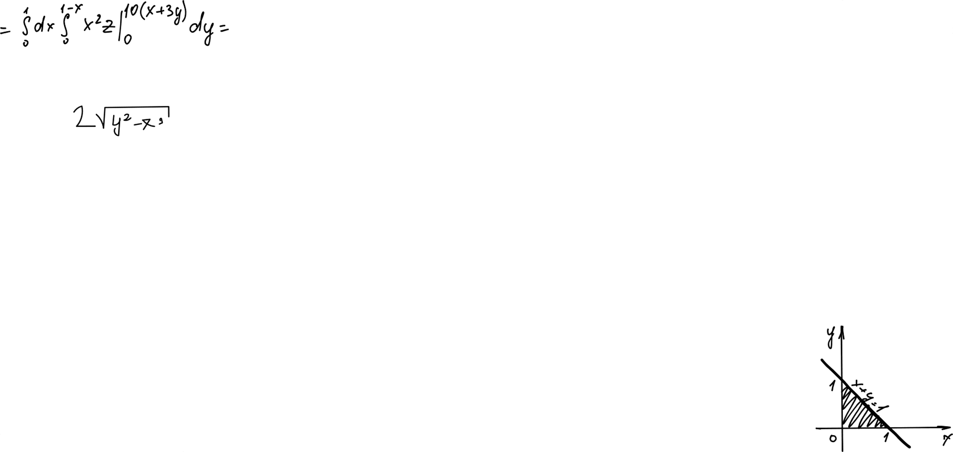
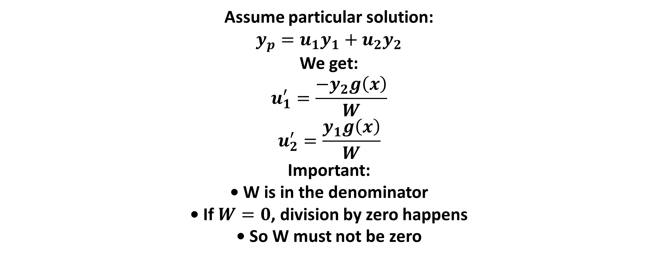
Where Is It Used?
Assume particular solution:
$$y_{p}=u_{1}y_{1}+u_{2}y_{2}$$
We get:
$$u_{1}^{′}=\frac{−y_{2}g\left(x\right)}{W}$$
$$u_{2}^{′}=\frac{y_{1}g\left(x\right)}{W}$$
Important:
• W is in the denominator • If $W=0$, division by zero happens • So W must not be zero

Slide 14
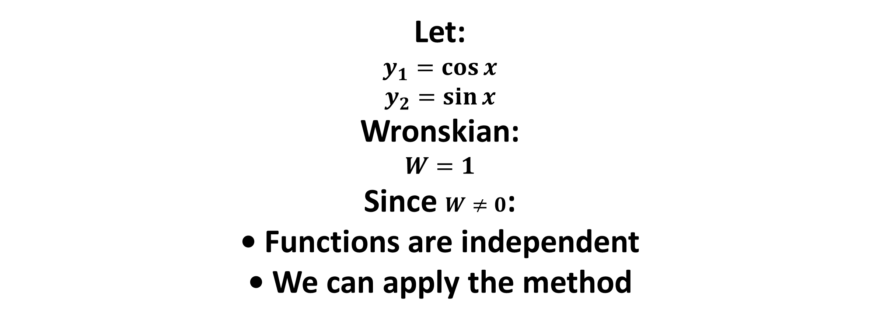
Simple Example
Let:
$$y_{1}=\cos{x}$$
$$y_{2}=\sin{x}$$
Wronskian:
$$W=1$$
Since $W≠0$:
• Functions are independent • We can apply the method

Slide 15
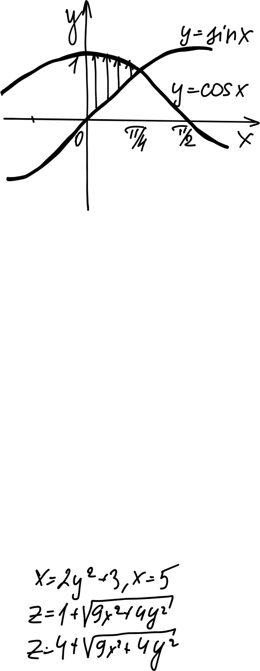
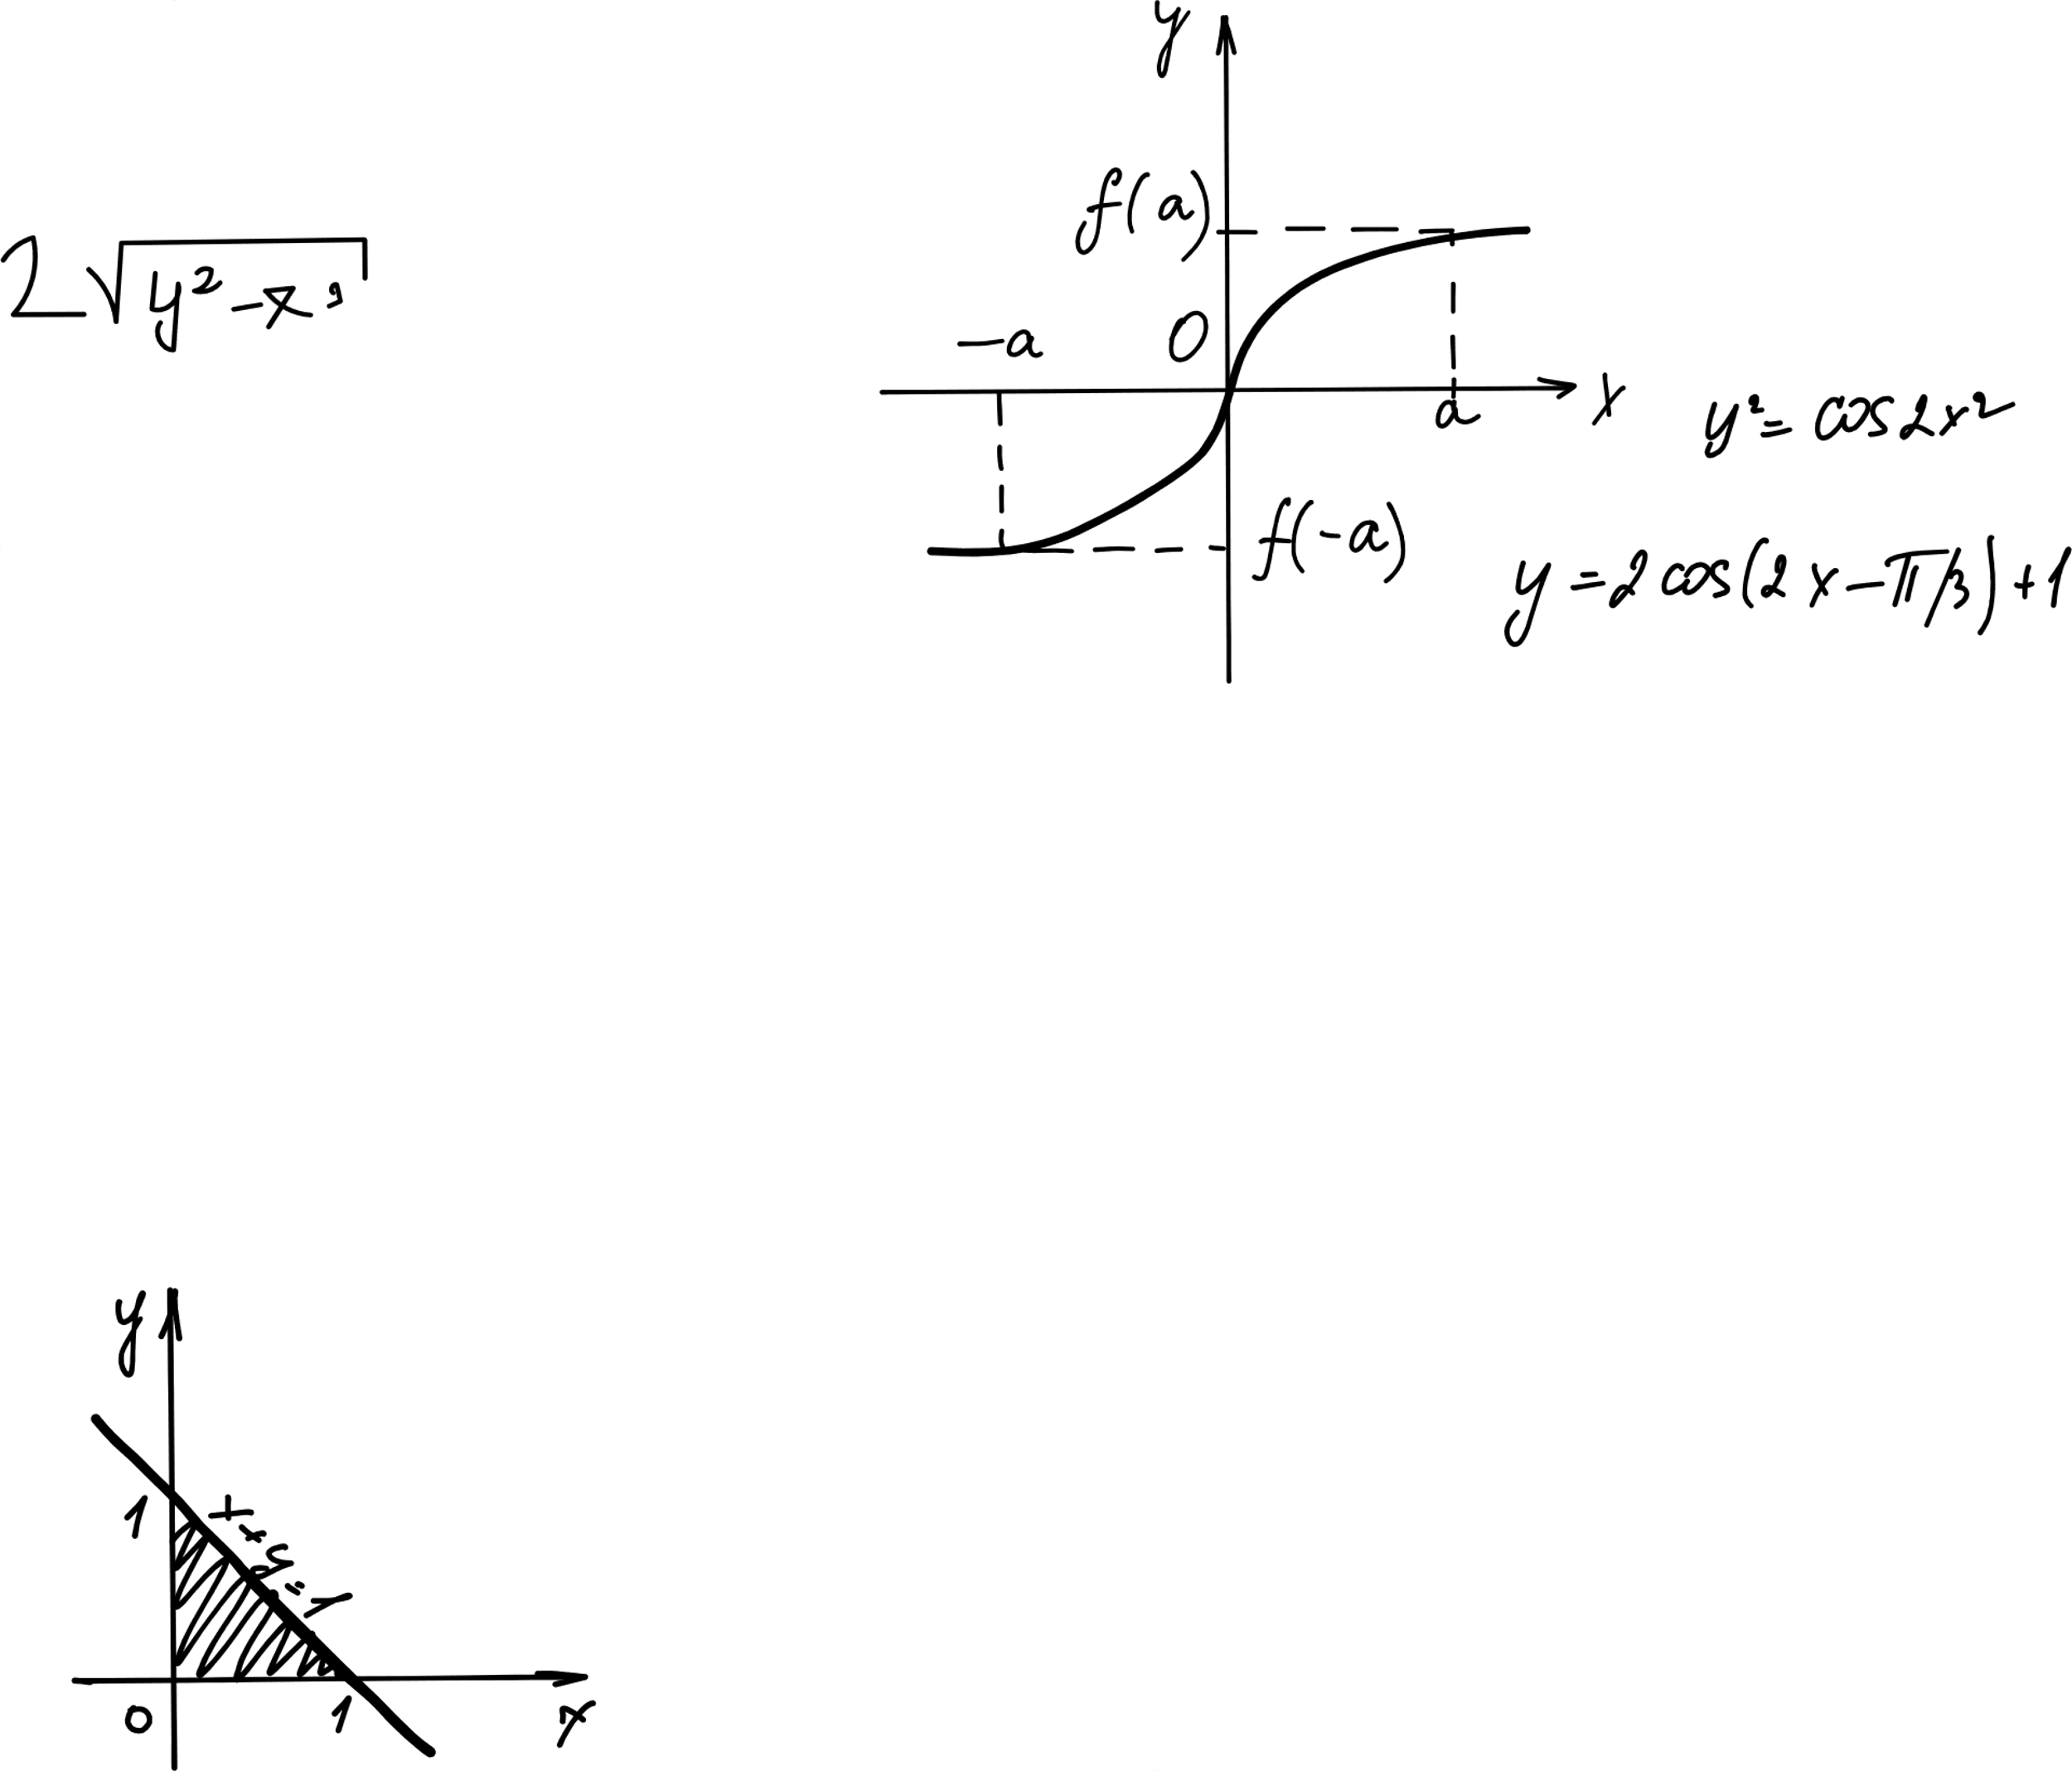

The Calculus

Slide 16
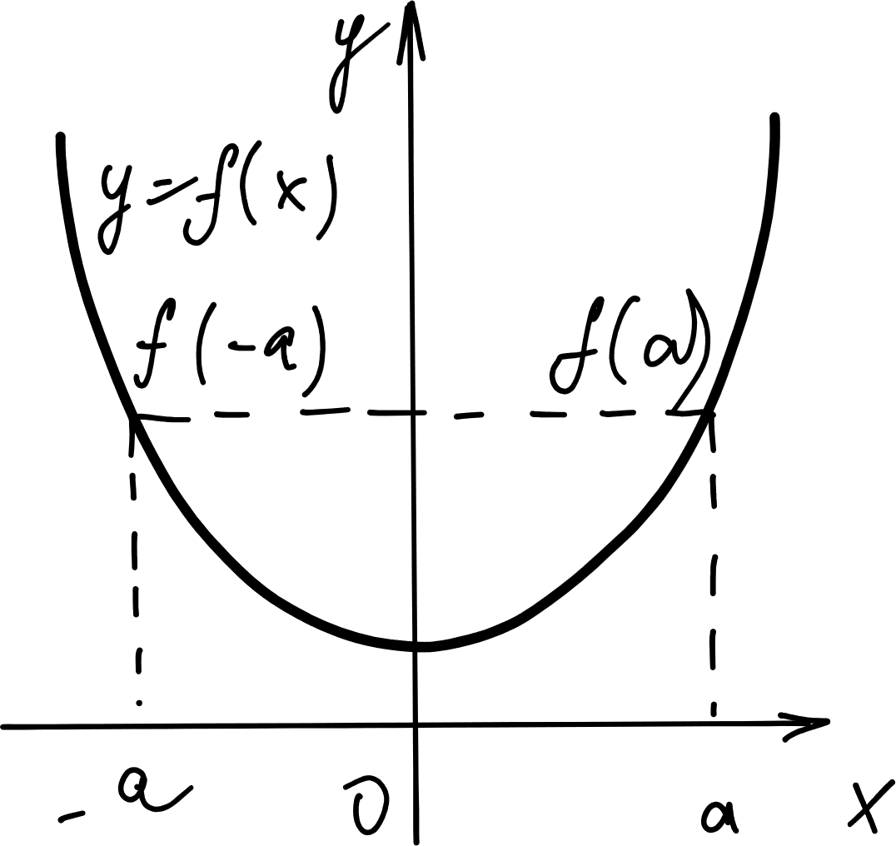
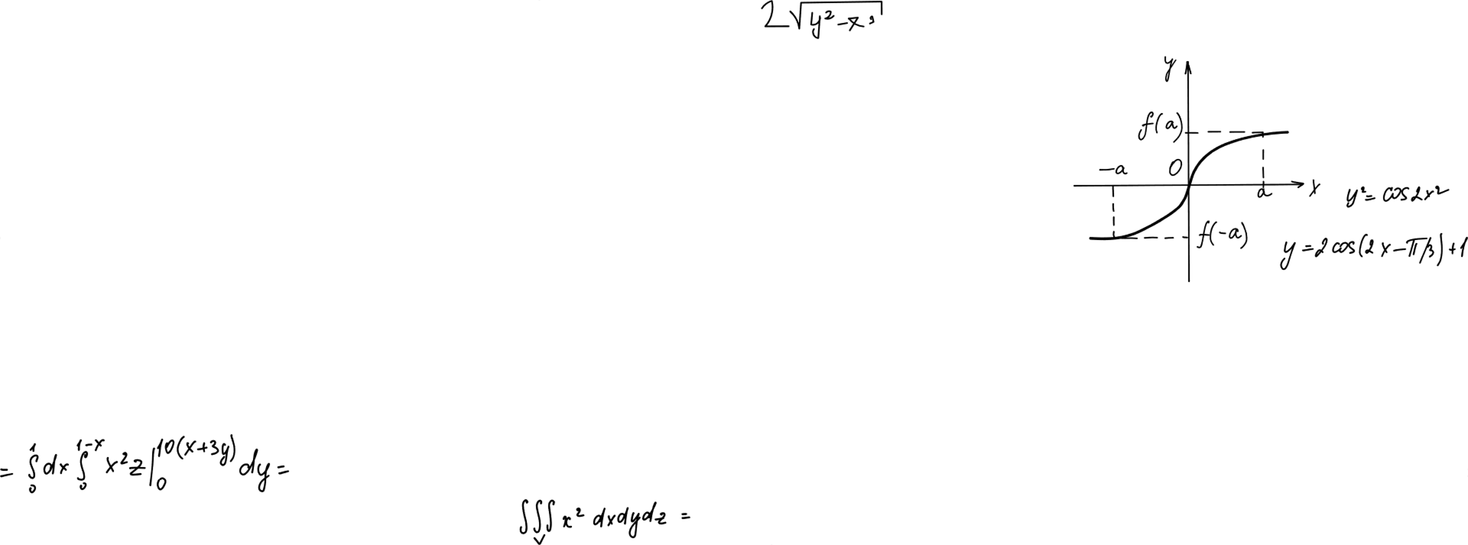
Finding u1 and u2
The Golden Formulas:
We need to find the integrals for u1 and u2.
Values: f(x) = sec(x) AND W = 1
Formula 1 (for u1):
u1 = Integral of [ (-y2 * f(x)) / W ] dx
Formula 2 (for u2):
u2 = Integral of [ (y1 * f(x)) / W ] dx

Slide 17
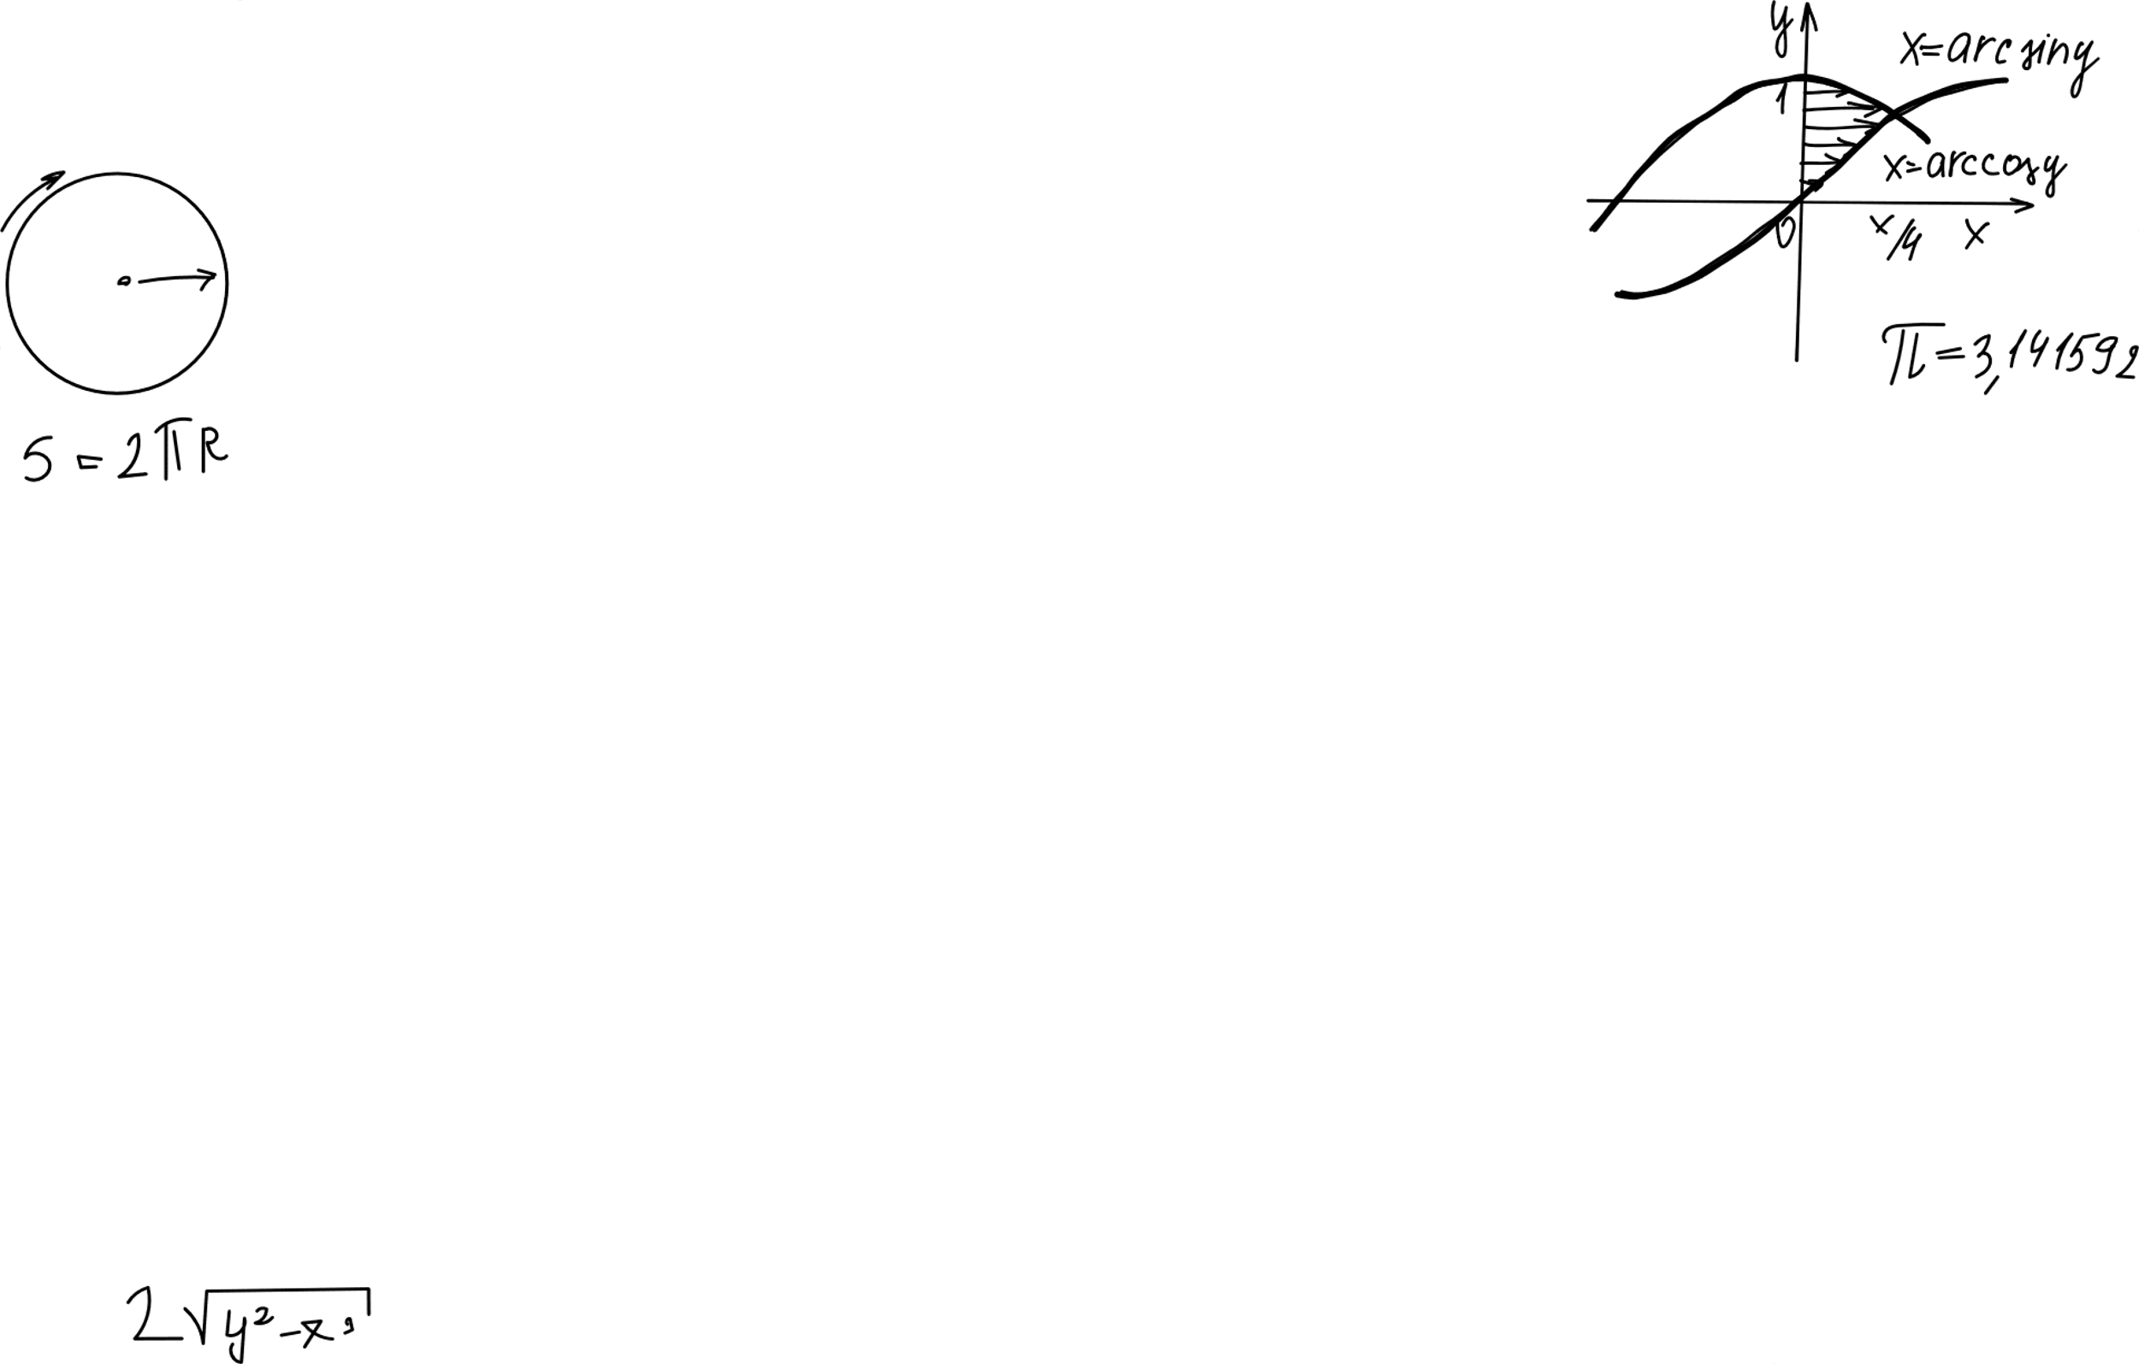
Solving for u1
Substitute Values:
u1 = Integral of [ -sin(x) * sec(x) ] dx
Simplify:
Recall: sec(x) is 1/cos(x).
So, -sin(x) * (1/cos(x)) becomes -tan(x).
Perform Integration:
Integral of -tan(x) is ln|cos(x)|.
Result:
u1 = ln|cos(x)|

Slide 18
Solving for u2
Substitute Values:
u2 = Integral of [ cos(x) * sec(x) ] dx
Simplify:
cos(x) and sec(x) are opposites (reciprocals).
When multiplied, they equal 1.
Perform Integration:
Integral of 1 dx is just x.
Result:
u2 = x

Slide 19
The Final Solution

Slide 20
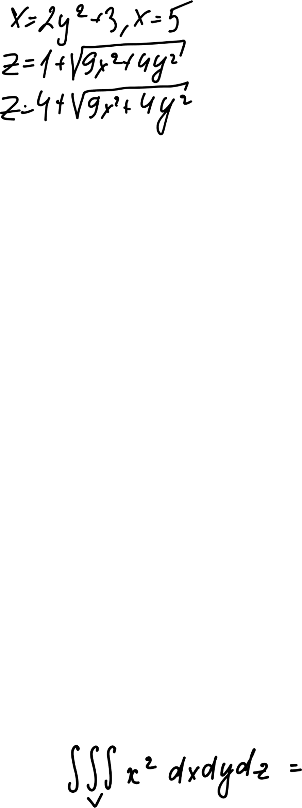
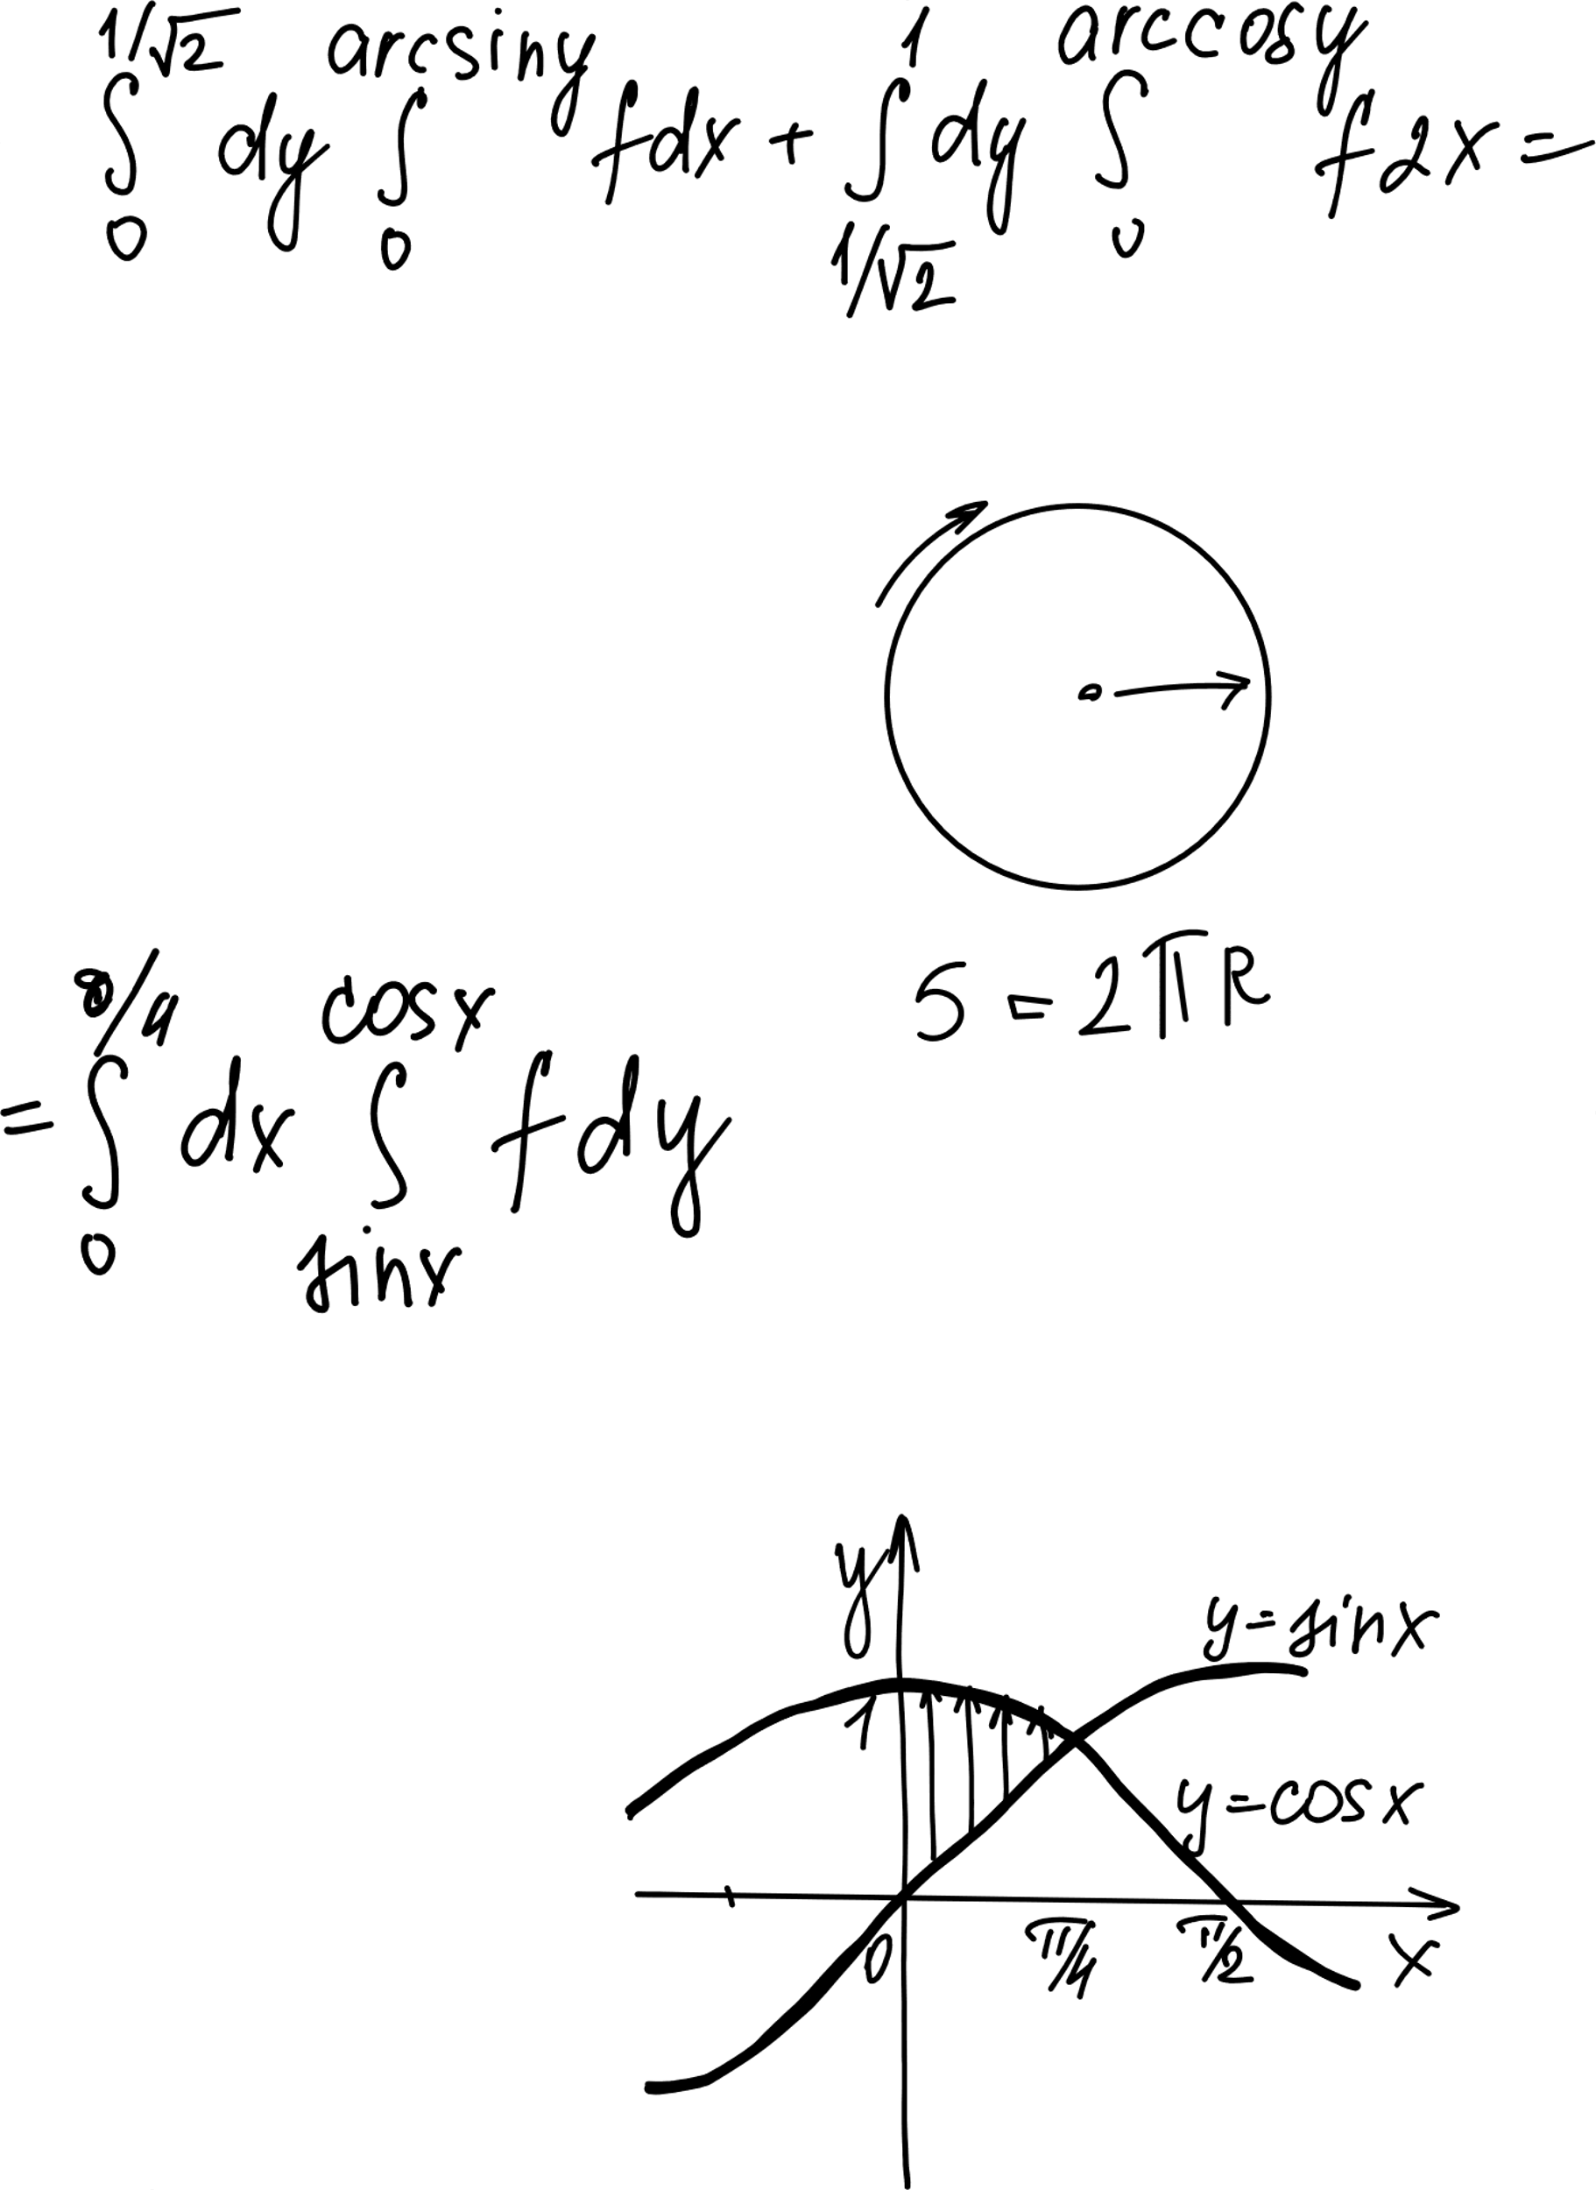
Step 4: Building y_p
Recall the Formula:
y_p = (u1 * y1) + (u2 * y2)
Plug in the Pieces:
u1 = ln|cos(x)|
y1 = cos(x)
u2 = x
y2 = sin(x)
The Result:
y_p = cos(x) * ln|cos(x)| + x * sin(x)

Slide 21
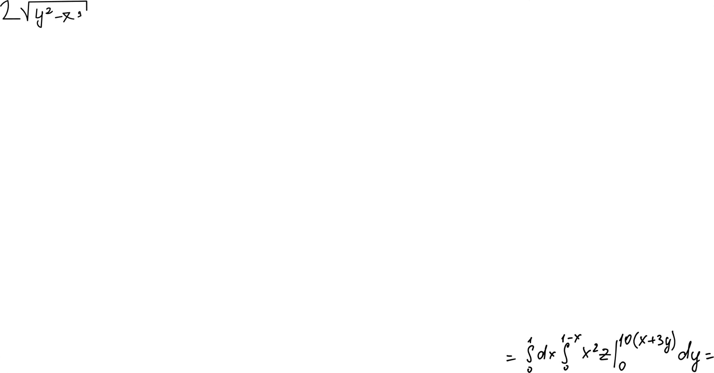

The General Solution
Combine Both Parts:
General Solution = Homogeneous (y_c) + Particular (y_p)
Write It Out:
y = [C1cos(x) + C2sin(x)] + [cos(x)ln|cos(x)| + xsin(x)]
Conclusion:
This equation represents the complete behavior of the system.
The Final Answer

Slide 22
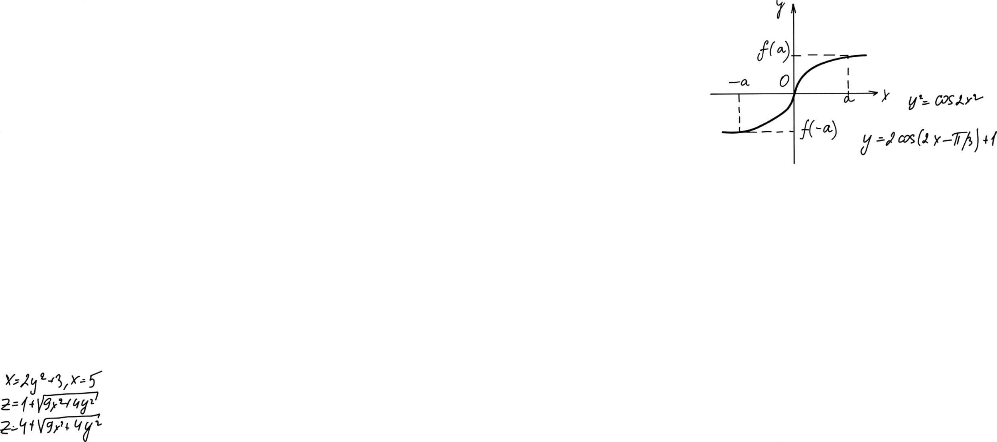

Conclusion
Why use Variation of Parameters?
It is robust and works for complex functions where other methods fail.
Recap of Steps:
Solve Homogeneous: Get your y1 and y2.
Wronskian: Check determinant (W).
Integrate: Find u1 and u2.
Combine: Add them together.

Slide 23
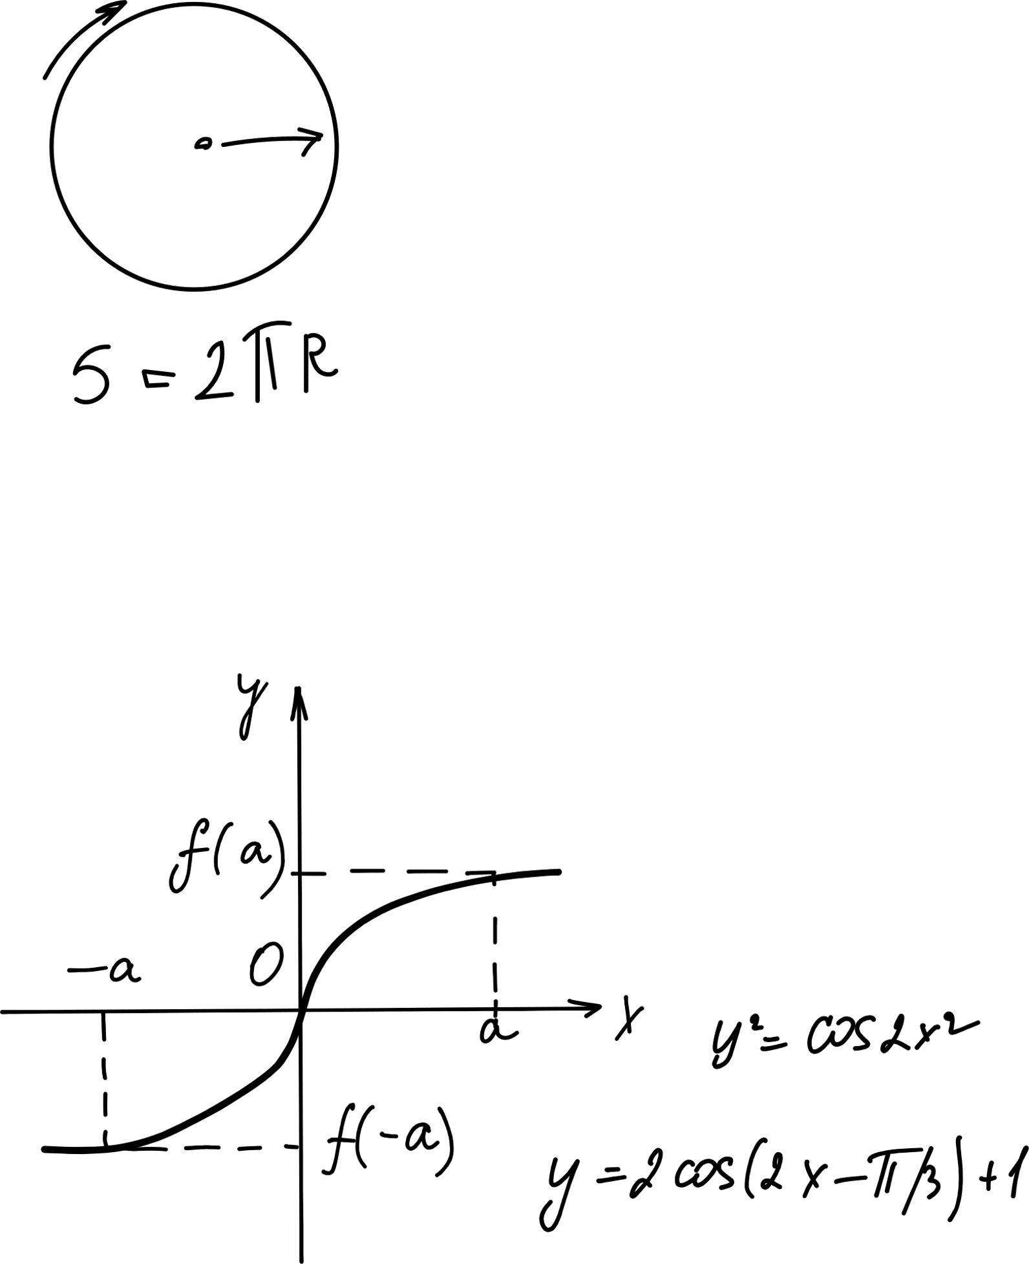
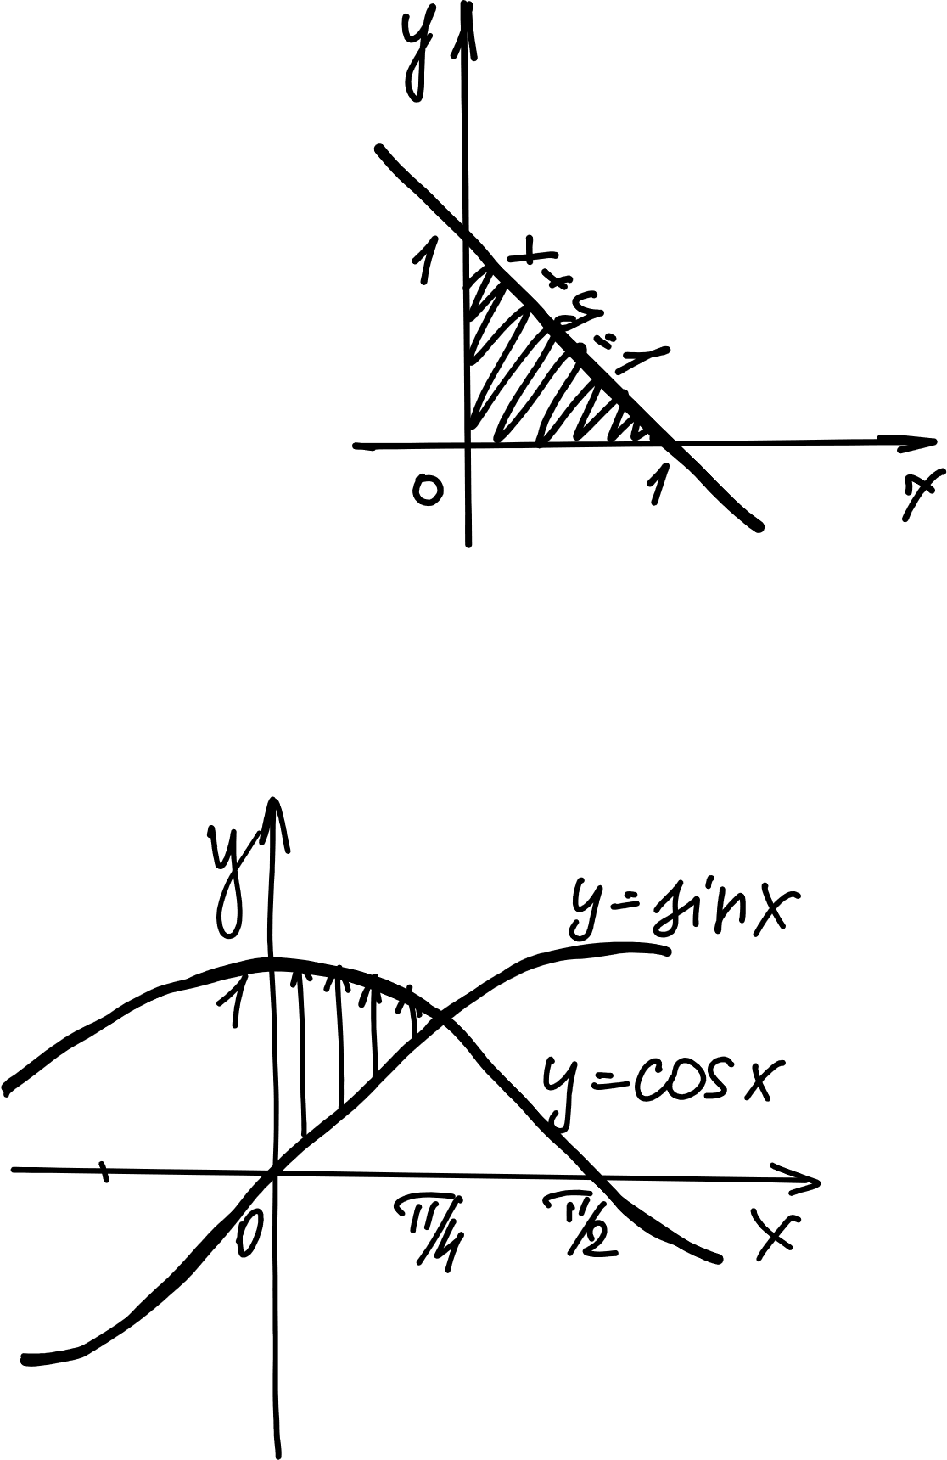

Thank you!
Any Questions?

